Slide 1


Analytics Software for Intel's CPU Test Results
Presenter: Roi Shamayev
Supervisors: Prof. Miri Weiss-Cohen & Alexei Raskin (Intel)
by roi shamayev

Slide 2
Introduction to Burn-In
Burn-In (BI) is a stress testing process where processors are subjected to extreme conditions like high temperatures and voltages to identify failures.
During development, BI helps uncover potential hardware issues that may arise under stress, allowing engineers to address them before mass production.
Ongoing BI ensures that processors can handle real-world conditions, improving reliability across the entire lifecycle of the product

Slide 3
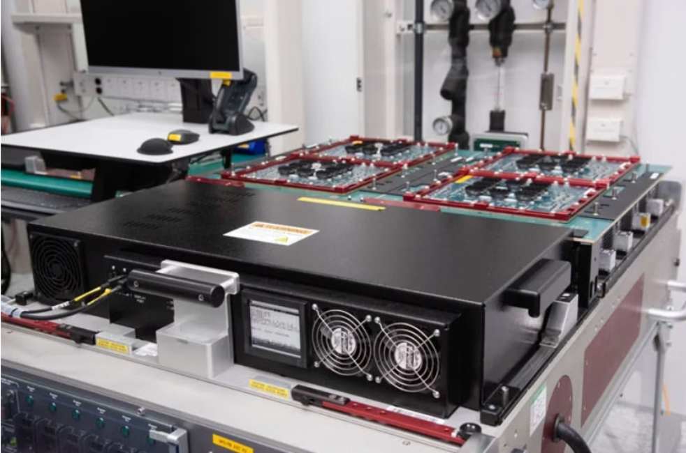
BI Tester example
Tester applies stress on underside of the large PCB

Slide 4
Current testing process in Intel
1
Burn-In (BI) Process
2
Log Data Generation
Intel’s Haifa Development Center conducts Burn-In testing to identify issues under stress testing.
During testing, vast amounts of log data are produced, containing critical information about the performance and status of the processors.
3
Developments phase:
4
The process repeats
Based on the results of tests, Engineers develop fixes to failures.
until the product is released for mass production

Slide 5



Current Challenges
Lack of Real-Time Data
Time Loss Due to Tester Malfunctions
Planning Inefficiencies
Engineers have to wait for test completion to receive automated summaries.
Inefficient planning and coordination among lab teams.
Productive time is lost when testers malfunction or human errors occur.

Slide 6
Project Goals
Real-time data monitoring
Reduced response and recovery times
Improve resource planning
Enable stakeholders to monitor test results in real-time and make data-driven decisions
Reduce response time to failures and recover quickly from hardware errors
Allow for better cooperation between stakeholders based on live data

Slide 7

Proposed Solution
The proposed solution is a Full Stack Web App - A dashboard that will display real-time results of different CPU’s , including key Metrics.

Slide 8
Research Approaches
Understanding Equipment and Software:
Analyzed log formats and data paths.
Identified keywords and metrics for parsing.
Collaboration with Experts:
Meetings with subject matter experts to understand log semantics.
Schedule meeting with stakeholders to understand requirements

Slide 9
Algorithms and Technologies
Log Parsing Techniques:
Implement algorithms to extract key metrics in real time.
Anomaly Detection:
Use Data interpolation to detect anomalies.

Slide 10
Technology Stack
Backend:
C# .NET Worker Service.
API for data requests.
Database:
MariaDB SQL.
Frontend:
Angular framework

Slide 11
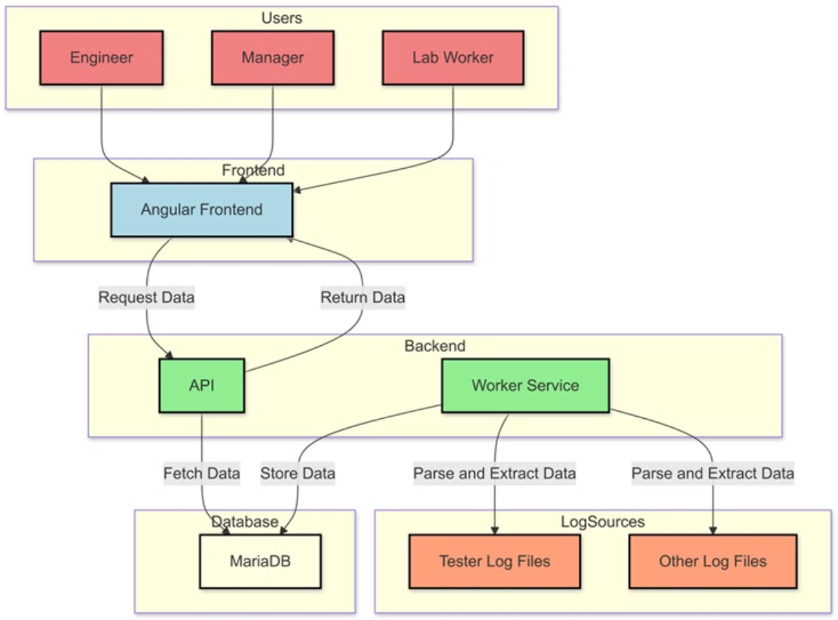
System Architecture

Slide 12
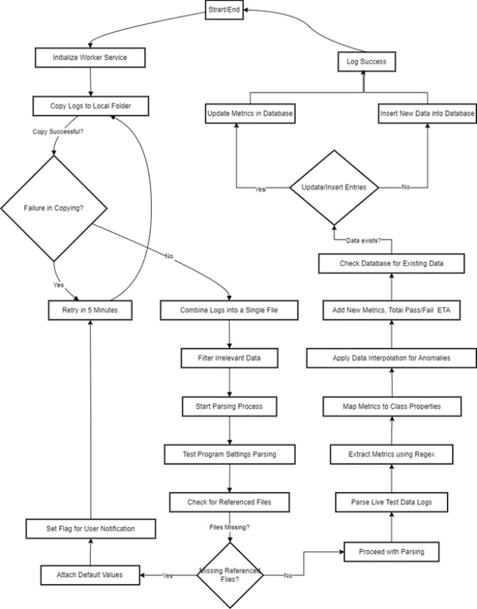
Worker service Architecture
Initialize Service: Start service and set configurations.
Copy and Preprocess Logs
Parse and Extract Key Metrics
Anomaly Detection and Metrics Calculation
Update Database
Continuous Loop

Slide 13
Definitions
Serial ID - A unique identifier for a specific CPU
Lot - a unique identifier for a group of CPU’s
Location code(L.C.) - Identifier used In combination with Lot to define which test program will run on the CPU’s
BIN - A number, Refers to binning ,process of sorting and categorizing CPUs based on their performance . Usually Bin 1 or 100 indicate a good CPU , and other Bins suggest a problem in a specific submodule assigned to that bin.
Cell - The identifier of the Tester equipment
Socket - As different cells have multiple sockets, each socket is identified by its number
Retest - Defines the number of times a test was performed on a processor
Stress Time - The runtime of the CPU under stress test conditions.

Slide 14
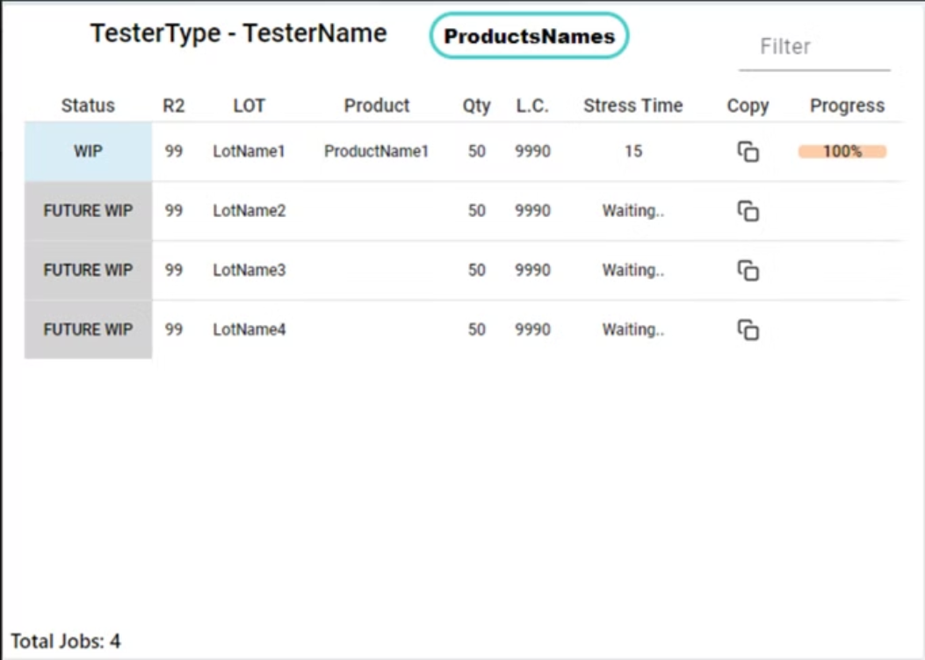
Prototype
Card component - This component hold the currently running lots leveraging built in components in Angular

Slide 15
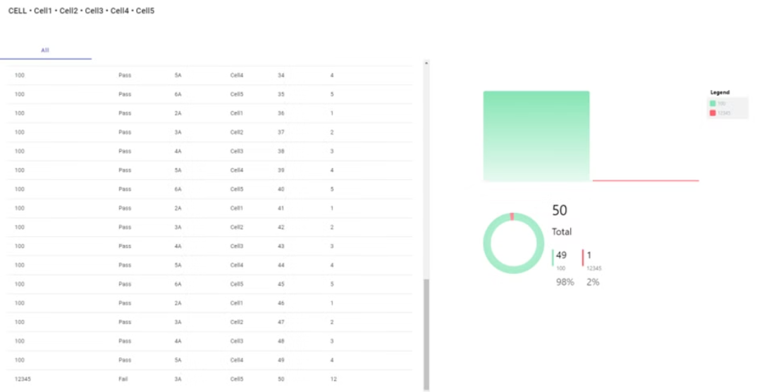
Prototype
Result component - This component display the processors testing results and uses the ngx-charts library for visualization

Slide 16
Evaluation Metrics
Response Time Reduction:
50% reduction in response time to test failures.
Recovery Time Improvement:
75% reduction in recovery time from hardware issues.
User Satisfaction:
80% satisfaction rate among users.
Data Accuracy:
Achieve a 99.9% accuracy rate in data representation.

Slide 17
Early Feedback and Impact
Real Cases
Overstressing CPUs:
Detected higher-than-expected stress times, leading to prompt corrections.
Quick Recovery from Errors:
Reduced downtime from days to less than an hour after human error.
Features Requests from users
ETA (Estimate Time) to End Of Test
Yield metrics and visualizations
Export to excel button and more

Slide 18
Completed Web App Demo video

Slide 19
Results
Streamlined workflow between all employees
98% Uptime
Reliable detection of overstressed CPU’s
Reduced recovery from HW failures to the minimum (30 min)
100% data accuracy

Slide 20
Limitations
Complementary Tool:
Provides comprehensive overview , But Does not replace in-depth analysis by engineers.
Network Constraints:
Data update frequency balanced to prevent network strain.

